Slide 1
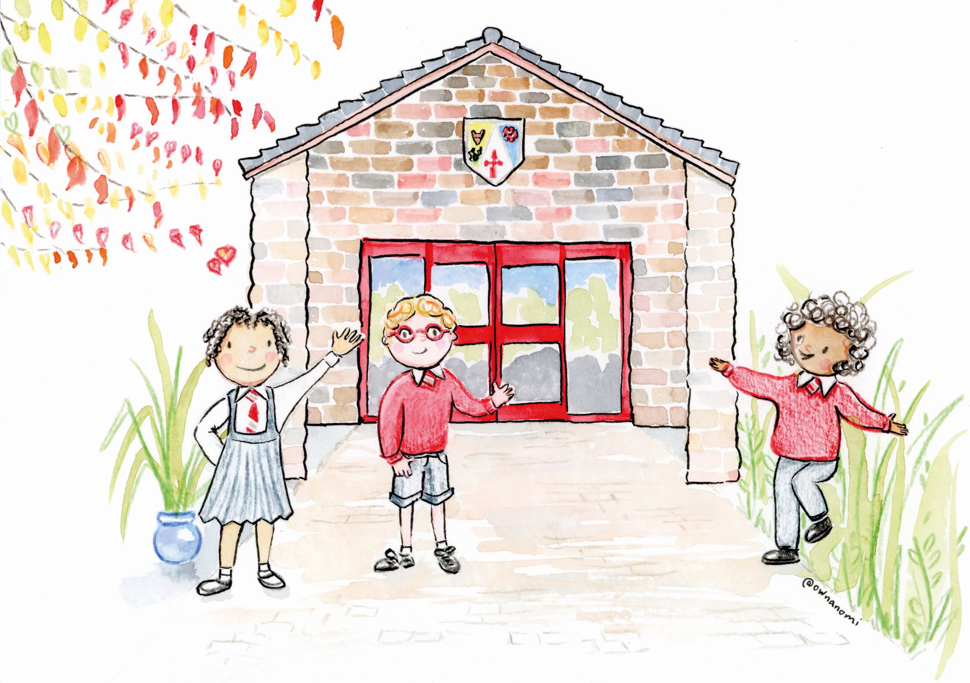
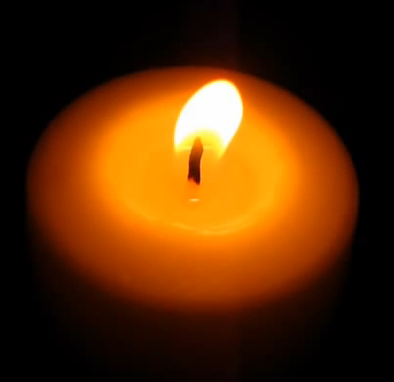
Welcome back
Summer 1
Notes:
Welcome back, as we gather together. Let us take a moment to prepare ourselves for our new term

Slide 2

This is the day that the Lord has made
Let us rejoice and be glad in it

Slide 3
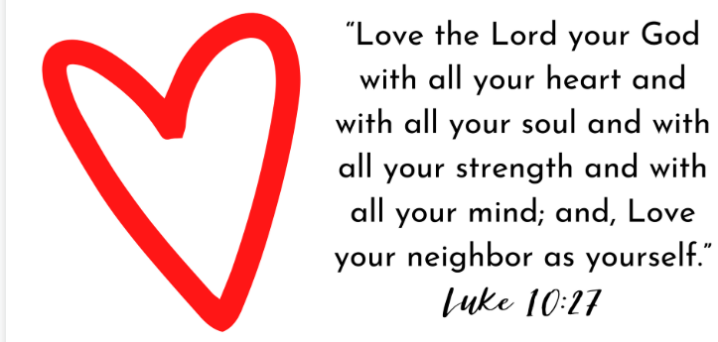
Our new vision statement
Notes:
Over the last few months, we have been asking parents, spiritual ambassadors, governors and all staff their view on our vision statement. This is about what we all believe we want our school to be about and what we want for you.

Slide 4
Our Vision Statement
Luke 10:27
Love God, Love Your Neighbour, Love Yourself
Notes:
Welcome back.
I hope you all had a wonderful Easter.
Today’s worship is focussed on our new vision statement. Thank you for helping us to choose this.
We have decided on:
Love God, Love
That’s a lot of love. But what does it actually mean for us in school, in our families, and in our world?
Let’s explore it together.
Your Neighbour, Love Yourself

Slide 5
Love God
What could this mean?
Notes:
Explain:
Loving God isn’t just about saying words. It’s about noticing the good things around us — our friends, our families, our teachers, our world — and being thankful.
It’s about trying our best to live in a way that makes God smile.
You might love God by:
- Saying thank you for the day
- Helping someone who needs it
- Using your talents
- Enjoying the world God made

Slide 6
Love Your Neighbour
What could this mean?
Notes:
Explain:
In the Bible, Jesus teaches that our “neighbour” means everyone — not just the person who lives next door, but:
- The person sitting next to you
- The person who feels left out
- The person who is different from you
- The person who needs a friend
Tell a short story:
Imagine you see someone in the playground sitting alone. You have two choices:
1. Walk past
2. Stop and say, “Do you want to play with us”
Which one shows love for your neighbour
Let the children answer.

Slide 7
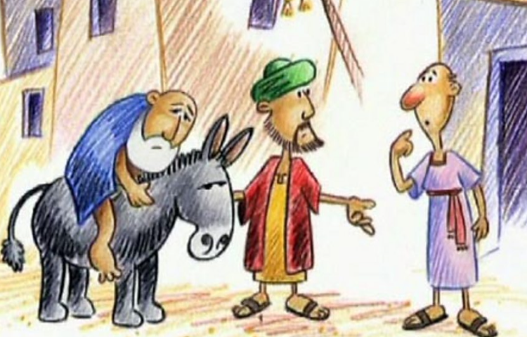
Notes:
https://www.bbc.co.uk/bitesize/guides/zwxm97h/revision/6
Jesus was asked to confirm what he meant by the word ‘neighbour’. This is when he told the Parable of the Good Samaritan (Luke 10:25-37), to explain that people should love everyone, including their enemies. It is easy to love friends and family, but it is much more difficult to love those who you may not get along with, or even those who may harm or hurt you. To show love to your enemies is to truly love as Christ did.
Parable of the Good Samaritan
In the Parable of the Good Samaritan, Jesus uses the example of the Jew and the Samaritan, who would not ordinarily have been friendly towards each other. However, out of all those who could have helped the Jew, only the Samaritan did. Jesus tells of a man who was travelling from Jerusalem to Jericho and was attacked by robbers on the way. He was badly beaten and left for dead.
The first person to pass the injured man was a priest, who crossed the road and continued walking.
The second person to pass the injured man was a Levite, a priest’s assistant. He also crossed the road and continued walking without helping the man.
The third person to come by was a Samaritan, a person from Samaria. The Samaritans were hated by the Jews. When the Samaritan saw the man, he took pity on him. He bandaged him and cleaned his wounds. He then put him on the back of his donkey and took him to an innkeeper, whom he paid to look after him.
The parable ends with Jesus giving a commandment to go out and do the same as the Samaritan had done. This teaching of loving one’s enemies is also reflected in Matthew's Gospel.

Slide 8
Love Yourself
What could this mean?
Notes:
Ask:
- Is it important to love yourself
- What does loving yourself look like
Explain:
Loving yourself doesn’t mean thinking you’re better than others.
It means remembering that you are valuable, precious, and wonderfully made.
You love yourself when you:
- Speak kindly to yourself
- Try again when something is hard
- Look after your body
- Ask for help when you need it
- Forgive yourself when you make mistakes
God made each of you unique — with your own gifts, ideas, and dreams.
You deserve to flourish.

Slide 9
Exciting Times Ahead
We have lots of exciting projects planned for you to help us to remember and celebrate this important message from the Bible
Create a school song
A collaborative art project
Any ideas?
Notes:
When we love God, love our neighbour, and love ourselves, something amazing happens.
Our school becomes:
- A kinder place
- A safer place
- A happier place
- A place where everyone can grow and flourish
This is the kind of community we want to be — a compassionate community where we reflect God’s love through our actions, our relationships, and our decisions.
We will be celebrating our vision statement in different ways: creating a song; art work – have you any ideas

Slide 10
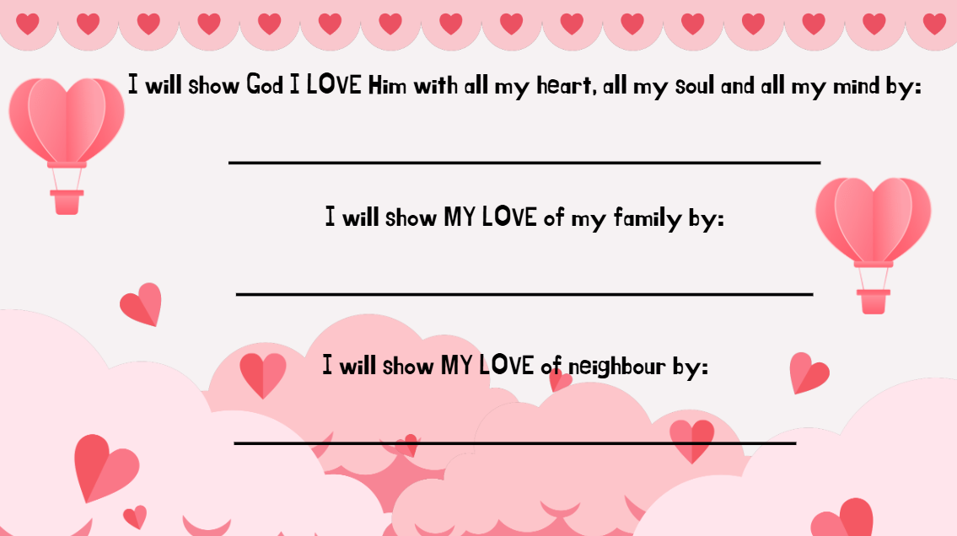
Class worship focus this week:
Notes:
Exciting opportunities ahead to explore and showcase our vision statement.
Have you any ideas? Let your spiritual ambassador or class teacher know.
Reflection:
Think of one way you can show love today.
Maybe you can help someone.
Maybe you can be brave and try your best.
Maybe you can say something kind to yourself.
Hold that idea in your mind.
Optional Prayer:
Dear God,
Thank you that we are loved.
Help us to love you,
to love our neighbours,
and to love ourselves.
Help our school to be a place of kindness, courage, and compassion.
Amen.

