Slide 1
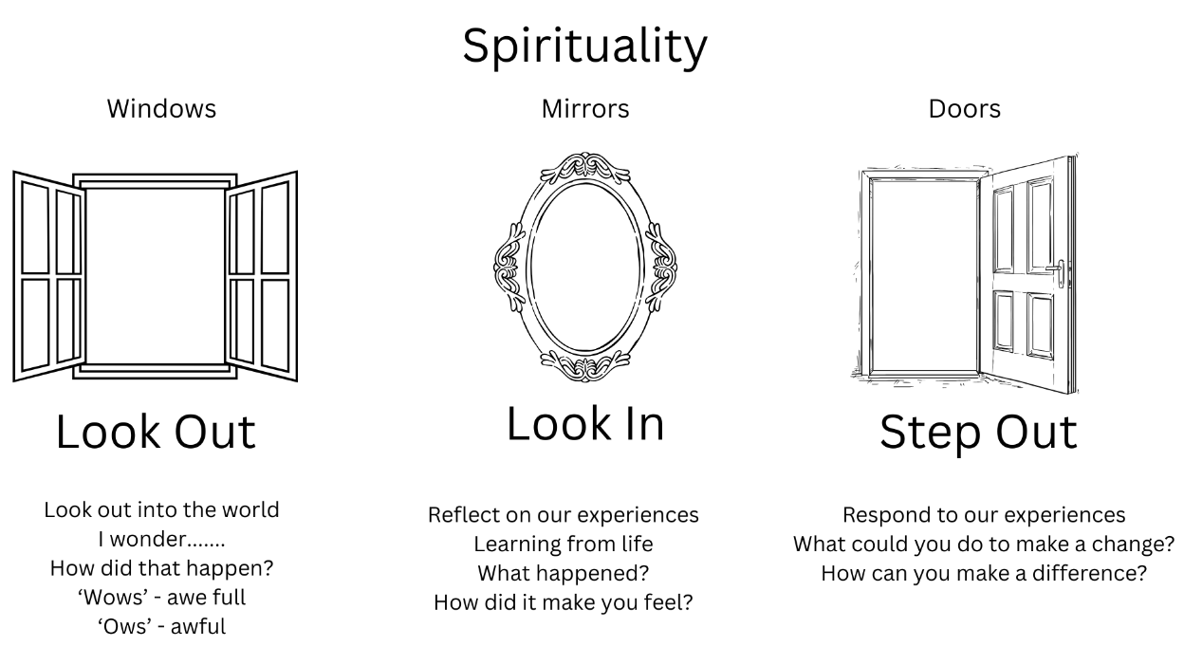

Slide 2

Look out
I wonder…..

Slide 3

Time to reflect
What did you discover in this story?
How did it make you feel?

Slide 4

Time to respond
What can you do in response to what you have reflected on today?
How can you make a difference?

