Slide 1

Curriculum Meeting
Year 4
Mrs Collister/Mrs Milne/Miss Gwynne

Slide 2


Year 4 Timetable
English and Maths
English is taught daily. This is taught throughout the week as: Guided Reading, Comprehension, Grammar, VCOP, Writing, Spelling, Dictation and Proofreading and Handwriting.
English is also part of other subject areas such as R.E. Science, Creative Curriculum.
Maths is taught daily. Children start by completing a short ‘Settling Down’ task and then move on to the main focus of the lesson.

Slide 3
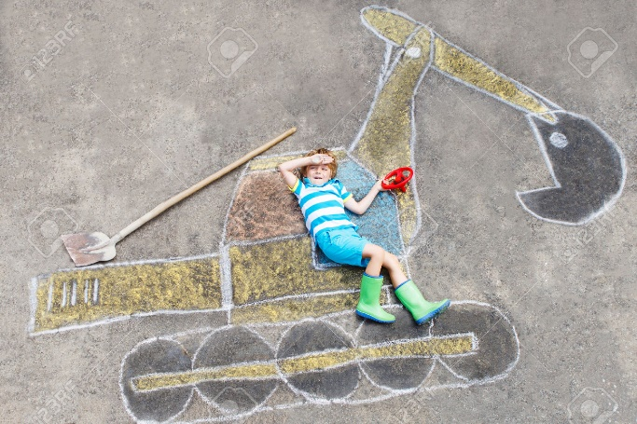
Other Subjects
R.E. Science, Creative Curriculum, ICT, Music, P.E. and Spanish make up the rest of the curriculum and are taught in proportion to requirements of the National Curriculum.
Enrichment allows the children to explore creativity on Friday afternoons from 1:30 – 3:30pm.

Slide 4

Homework
Children are expected to complete H/W tasks on a weekly basis, to support pupil’s learning in school.
This takes the form of:
Blue Book (English) 3 week rota of a written task, a grammar task and a comprehension task. Children will tick their name off when they bring in their Blue Book.
Reading (Daily) – 3.10 – 3.30
Maths – My Maths Task – linked to current topic in Maths. If children are unable to complete My Maths at home due to no laptop etc. please let us know so we can arrange for them to do it at school.
Weekly Spelling

Slide 5

Pupil Expectations
Spelling test and taught new spellings – Friday. Spelling journals need to be in on this day.
Blue Book – take home on Friday complete and hand in by following Wednesday
My Maths – Set on Friday - complete by following Wednesday.
Homework diaries should be in school every day.

Slide 6
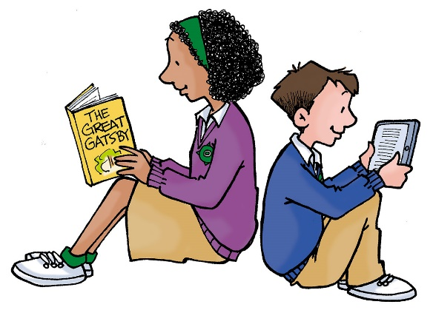
Homework/ Reading Diary
Teachers check and stamp the diary on a Monday morning. This is another form of communication for parents to write messages about your child’s learning or homework.
This is a good way of keeping the line of communication open as we realise that it is not always easy to speak to the teacher before or after school.
Please check your child’s diary each evening to see the types of questions that they are working on in Maths. There will be a simple Maths question linked to learning.
Please sign you child’s diary each week so we know you’ve seen any messages and events for the week.
Please sign your child’s diary whenever you have read with them. This helps us to see that children are getting that vitally important time at home.

Slide 7
Reading in school
This year, our main school focus is reading.
.Every day (except Thursday due to assembly), we stop other work to read at 3.10pm. Once day will be for paired reading, one may involve a trip to the library and the others will focus on our class novel.
We will be organising book swaps, author visits and various other exciting activities and events to inspire a love of reading in our children.
Booktober.

Slide 8
Reading at home
We cannot stress how important it is to read daily with your child.
Reading has a myriad of benefits; it helps children with their mental health, emotional intelligence, vocabulary, knowledge of the world and imagination to name but a few
It is what’s known as a ‘keystone habit’ in that it’s part of an elite set of habits where a focus on reading will caused a chain reaction and have an impact on several areas of learning.
It is a fantastic way to spend quality time together.
Furthermore, reading attainment is highly correlated with enjoyment.

Slide 9
Reading together
Reading together gives children vital access to a much wider set of life experiences and vocabulary than reading alone.
Whenever children are reading with an adult and happily chatting about what they are reading, they are learning so much more than if they were reading independently.
It’s a fantastic way to strengthen communication with your child. Real conversations rarely begin with “How was school?” but may well emerge when reading and talking about a story you’re reading.

Slide 10

Top tips for reading together
Choose texts that you will both/all enjoy (good quality picture books can appeal to children and adults of all ages!)
Make it part of a routine. We want our children to develop long-lasting reading habits.
Get comfy and read for at least 15 minutes. Studies have shown that many of the benefits of reading only really start to emerge at the 15 minute mark.
Take it in turns to read. Put on different voices for different characters.
Get into the nitty gritty of the book. Discuss words that might be unfamiliar to them.

Slide 11

Celebrations
‘Celebration Assembly’ is now on Thursday. This is the chance to celebrate the good work that your child has done in Year 4. All children will have the opportunity to share work in this assembly, throughout the year. If your child is up for assembly you will receive a text message from the school.
Harvest Service at St John’s Thursday 3rd October
Christmas service Y4/Y6 Wednesday 11th December 2.30pm, Thursday 12th December 6pm,

Slide 12
Rewards/Sanctions
Good to be green – warning system
This involves verbal warning, yellow card, red card. The yellow card can be removed if the child proves that they wish to amend their behaviour. If the yellow card still remains at the end of the day, or a child has received a red card, it is recorded on the school log. Red cards – letter sent home to parents.
Class rules – children have composed these rules themselves and they are also displayed in class.
Privilege – being helpful, kind, polite, good manners, great engagement, super contributions/answers
Gems in jar/table points – for collective work/team work/working together
Golden time weekly to reward good behaviour.

Slide 13
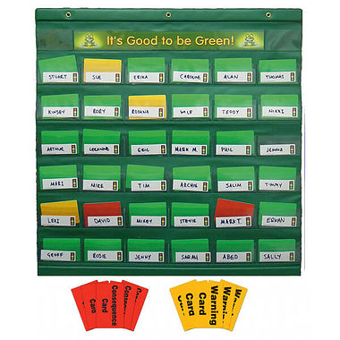

Slide 14
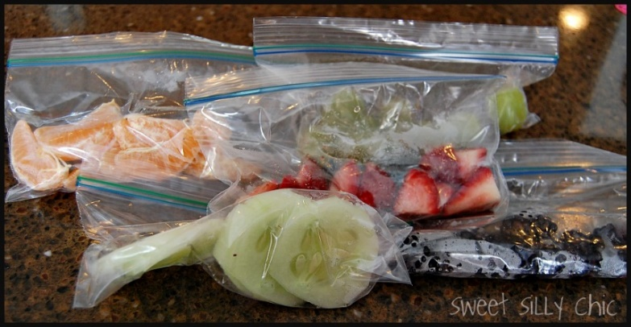
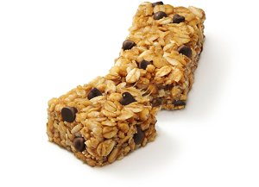
Snacks
Children can bring in a healthy snack to eat at their first break time these are to be kept in their desk till break.
Water bottles are kept in the classroom for children to access at all times. Please make sure the bottle is named and in school each day.

Slide 15

P.E.
P.E. – Tuesday/Thursday
Please provide your child with the correct kit for these days and make sure it is clearly labelled.
White t-shirt, black shorts (joggers for colder months), either a red Deanery hoody or a plain black hoody (for colder months). Trainers for outside P.E. Pumps for indoor games. Barefoot for gymnastics and dance.
If any children have recently had their ears pierced please ensure tape is brought into school to cover earrings. Children should then take earrings out (plain studs only) after the 6 weeks. If they can’t take them out themselves then please remove before school.
A letter will be sent home if your child is missing part of their kit on more than one occasion.

Slide 16

Maths
Maths is taught daily for 1 hour.
Morning session.
Structure – * S.D. – Settling down task (10 mins)
* Main teaching – differentiated to suit all children’s needs (45 mins)
* Plenary/Home work question

Slide 17
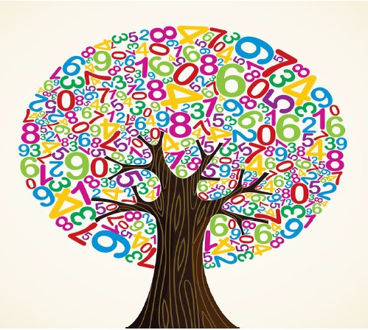
S.D. Questions
10.09.19
Obj: To partition numbers.
50 + 20 + ---- = 110 4. How many days are there in total
1/5 + 2/5 = in the months of December and June?
A man puts a cake in the oven at 2:30pm. 5. 4356 + 2110 =
It takes 50 mins to cook. What time will he need 6. How many vertices does a cube have?
to take it out?

Slide 18
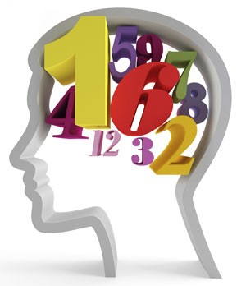
Homework question
Children will write a HW in their diary everyday. This is to be completed at home.
Linked to daily learning to allow parents to see which topic/style of questions the child is working on in school.
Could be as simple as:
What is the Roman numeral for 14?

Slide 19
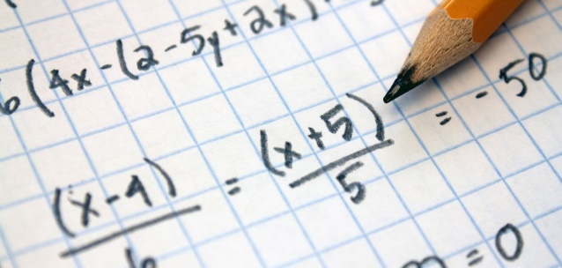
Calculations policy
Calculations are clearly set out to show how each area of learning is taught.
Some of the calculations will be set out differently to how you were taught in school.
There are sometimes more than one method taught to allow children some choice in their workings out.
Earlier years – heavier emphasis on practical methods and visual recordings.

Slide 20
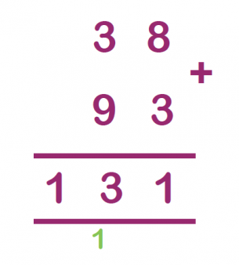
Year 4
Methods
Column method for addition and subtraction, extending to 4 digit numbers.
Developing the grid method in multiplication on to column multiplication.
Use of the bus stop method in division – dividing up to 3 digit numbers by a single digit.
Please see hand outs.

Slide 21
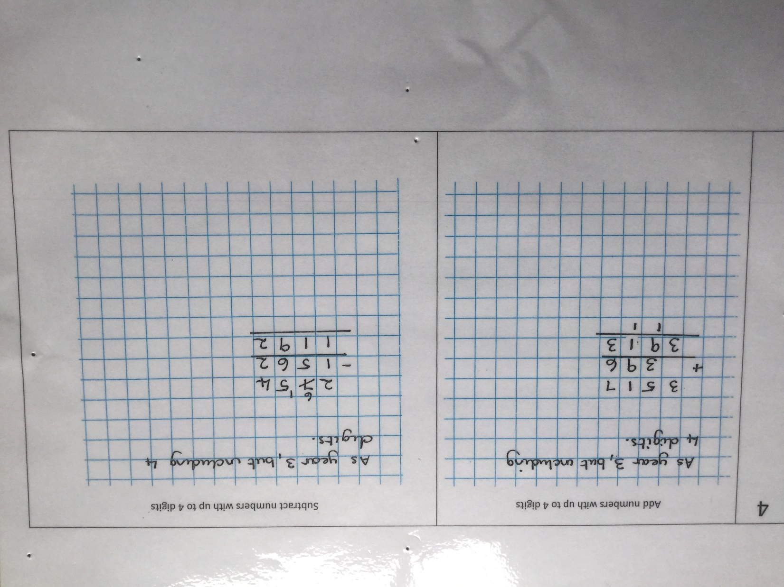

Slide 22
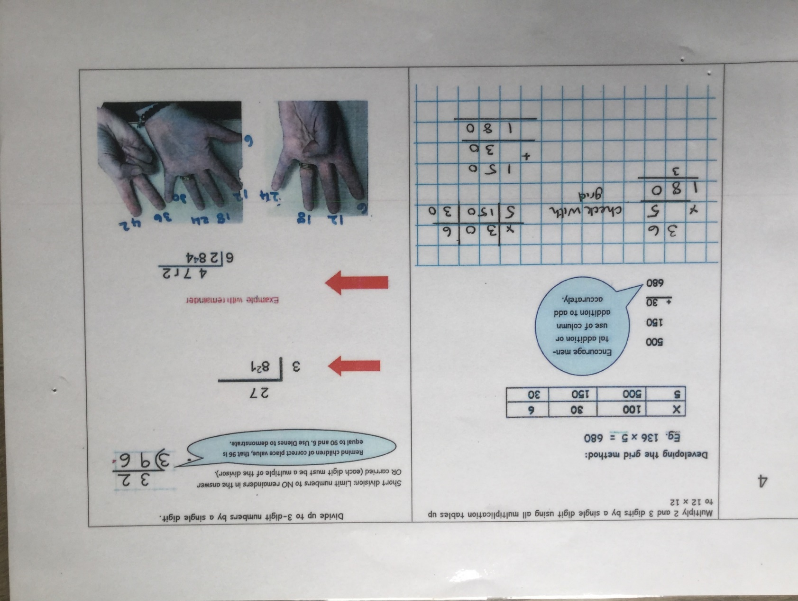

Slide 23

Year 4 Mastery Overview
This is used in planning to aid differentiation and is split into Fluency, Reasoning and Problem Solving.

Slide 24
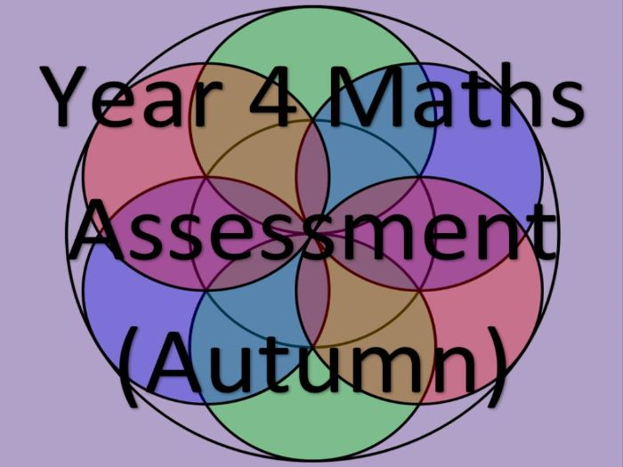
Assessment
Formative/Summative
Teachers assess pupils continuously throughout each topic.
We use this assessment to form the basis of our planning.
Once a term pupils are given a formal test for their arithmetic and reasoning maths skills.
This supports assessment and a record of progression is kept throughout the year.
Working towards, expected, greater depth

Slide 25
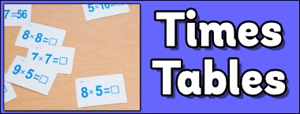
Times Tables / Multiplication Check
Pupils in Year 4 are expected to know the following tables:
X2 X5 X10 X3 X4
X6 X7 X8 X9 X11 X12

Slide 26
Times Tables / Multiplication Check
The purpose of the multiplication tables check (MTC) is to determine whether year 4 pupils can fluently recall multiplication tables.
“By the end of year 4, pupils should have memorised their multiplication tables up to and including the 12 multiplication table and show precision and fluency in their work.” 2014 National Curriculum.
Pupils should be taught to recall multiplication and division facts for multiplication tables up to 12 × 12.
However, it will only assess the instant recall of multiplication facts – division facts will not be tested in the check.

Slide 27
Times Tables / Multiplication Check
The MTC will be introduced in June 2020 (2019/20 academic year) subject to the approval of parliament. This means that children in England will be taking the test as a statutory requirement.
What will the multiplication tables check look like?
•There will be 25 questions worth one mark each. The questions will be in no particular order.
•Every question will follow the same format and will require the same type of response e.g. 4 x 8 = 32
•Children will have a maximum of six seconds to answer each question – this is based on research undertaken by the Standards and Testing Agency (STA). There will be a three-second pause before the next question is displayed.

Slide 28
•The emphasis will be on the "6, 7, 8, 9 and 12 multiplication tables", with two to four questions in every test taken from each of the 6, 7, 8, 9 and 12 multiplication tables, meaning that between 18 and 22 questions will focus on KS2 content.
•There will be no question reversals in any test. For example, "3 × 8 would not appear in the same form as 8 × 3".
•Children will be randomly assigned a test. The system will provide a range of tests, equal in difficulty, but with different questions in different orders. No test should have more than 30 per cent of the same questions as another test.
•Children will be able to access a "practice area" in the run up to the test window in June. This is so children can become familiar with the format of the test.

Slide 29



Slide 30


Slide 31


Slide 32

English
Taught daily for 1 hour ( 2 hours on a Thursday)
Morning session
Monday – Grammar, Tuesday – Spelling, Dictation/Proofreading and Handwriting, Wednesday – Guided Reading, Thursday – VCOP and Writing, Friday – Reading Comprehension
Structure: * S.D Settling Down Task (5 mins)
* Main Teaching: Input as a class (15mins) Tasks (30 mins). Differentiated by task, resources, adult support, independent/paired/group work.
* Plenary, Self Assessment/Peer Assessment, Tick objective (5-10 mins)

Slide 33
S.D Question examples
What is a – noun, verb, adjective, adverb?
How many adjectives can you think of beginning with S?
Choose the correct homophone for the picture.
Can you re-write these sentences with the accurate punctuation?
How do you know the house in the picture is haunted? What is the evidence?

Slide 34
Grammar

Slide 35
Year 4 Grammar
Word Structure – Plural and Possessive. Standard English form of verb inflections instead of local spoken forms (eg. We were instead of we was, or I did instead of I done.
Sentence Structure – Noun phrases expanded by the addition of modifying adjectives, nouns and preposition phrases (e.g. The teacher – expanded to – the strict maths teacher with curly hair). Fronted adverbials e.g. Later that day, I heard the bad news.
Text Structure – Use of paragraphs to organise ideas around a theme. Appropriate use of pronoun or noun within and across sentences to avoid repetition.
Punctuation – Inverted commas and other punctuation to indicate direct speech e.g. The conductor shouted, “Sit down!” Apostrophes to mark plural possession e.g. the girl’s name, the girls’ names.. Use of commas after fronted adverbials.
Terminology – determiner, pronoun, possessive pronoun, adverbial

Slide 36

Focus
Practice
Extension
Further support and extension worksheet available.

Slide 37
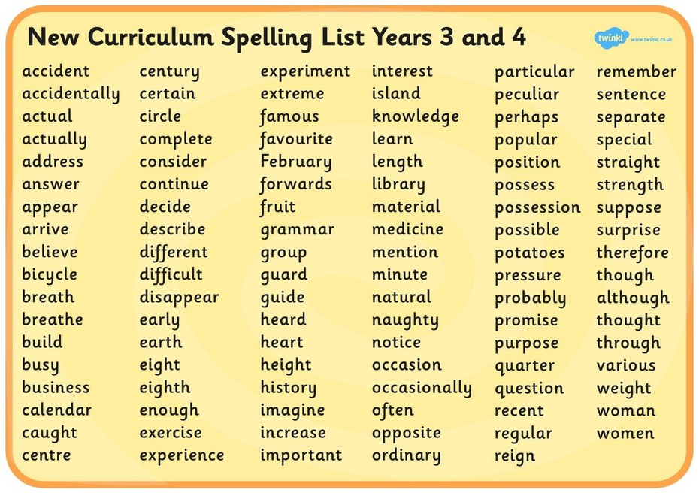
Spelling

Slide 38

Children will be tested on spellings within sentences.
It is expected that these spellings are being used in their writing.
They have the full spelling list in the back of their English books.

Slide 39
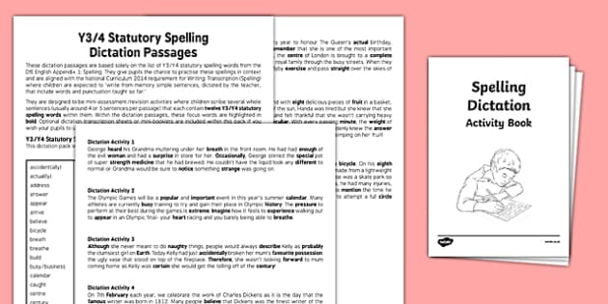
Dictation
2 or 3 sentences are read slowly a few words at a time.
Children are to write what they hear checking they’ve got every word and that spelling and punctuation is accurate.
Dictations include Year 3 and 4 Statutory Spellings.

Slide 40
Handwriting
From Year 4 children are able to achieve their pen licence.
Handwriting must be joined in the appropriate place, this is consistent throughout writing. Letters are appropriately formed and correct size.
‘Good handwriting’ is not just for English books. It is to be seen in all subject books.

Slide 41

Library
Children will visit the library once a week.
They have up to 3 weeks to change their books.
They can take 2 books out on their coloured band.
The teacher will decide when they can move up a band.
Their library barcodes are in the front of their homework diaries.

Slide 42
Guided Reading
Throughout the year, children will read and infer a variety of texts. Fiction, non-fiction, poetry in the form of books, text books and video clips.
Children are split into 3 groups and will spend the whole hour reading, discussing and interpreting the texts. Children will recall, summarise, infer, predict and explain.
The reading session focuses on 1 or 2 objectives at a time. The questions asked will be linked to these objectives.

Slide 43
VCOP
V – Vocabulary
C – Conjunctions
O – Openers (Fronted adverbials)
P – Punctuation
This session is the build up to the children’s writing. VCOP will be addressed through games and short activities. Children use vocabulary and sentences created in this session in their writing.

Slide 44
Writing
Children will complete an extended piece of writing. This may be independent, in pairs, shared or guided.
A modelled write will be produced with the children to give them a starting point. In this, the class works together to up level and improve.
Each child has to decide which aspects from the Y4 checklist they need to include in that week’s style of writing and must try to include these throughout. Children also need to acknowledge their two targets and ensure they are using these in their writing. Children will self assess their work against their chosen WILF, highlighting each aspect.

Slide 45
Targets
Children are given two writing targets each half term.
It is expected that they then use these targets in every piece of extended writing in any subject including writing homework.
If it is evident that children have improved that skill and are now using it confidently, the target will change in the next half term. If children need further practice, they will keep that target for a further half term.
When it is writing homework, children need to try to include their targets where possible. Writing homework is aimed to be an extended writing task to give the children an opportunity to independently write at length. Before giving in writing homework, they need to highlight/underline their T1 and T2.

Slide 46

Reading Comprehension
Understanding the test
Looking at language
Exploring the characters
Taking it further
Further support and extension work sheets available.

Slide 47
Assessment
Formative and Summative
Teacher’s assess children daily to form the basis of planning and consecutive lessons.
At the end of each half term, teachers moderate and assess the children on the objectives covered and asses against the Chris Quigley milestones.
Once a term, children are assessed in formal tests for writing, reading comprehension, grammar and spelling, maths arithmetic and reasoning. Results are recorded and given back to the children.

