Slide 1
Year One.
Curriculum and Information
Evening 2019.

Slide 2
Overview of Year 1
Routines of a typical day
Topics covered
Timetable
Maths
English

Slide 3
Overview of Year 1.
5 members of staff
Teachers
Mrs Hickling and Miss Stableford (1HS)
Mrs Bourne (1B)
Teaching Assistants
Mrs Trouth (1B)
Mrs Wyatt (1HS)
Staff are split into their own specific classes, however we work closely together as a year group and follow the same lessons.
For the Autumn term, Maths and English are taught Reception style to aid transition.

Slide 4
A day in Year 1.
AM
Register
Visual timetable
Morning prayer
Maths / English
Assembly / Class Prayer
Play time (including snack)
Phonics
Maths / English
Lunchtime
PM
Register
ERIC (everyone reading in class)
Foundation subjects (PE, ICT, Music, Creative Curriculum, RE)
Play time (including snack)
Foundation subjects
Whole school reading
Home time

Slide 5
Topics covered.
Autumn 1- Jobs
Autumn 2- Memories
Spring 1- Significant People
Spring 2- Toys
Summer 1- Transport
Summer 2- The Environment
You will find the Programme of Study available on the school website for more
information about each topic area and what we will be learning in each subject.

Slide 6
Timetable.
Maths and English daily
Phonics daily
Spellings x1 a week
Handwriting x1 a week
SPAG x1 a week
PE x 2 a week (Monday PM and Tuesday PM)
RE x 1 a week
ICT x 1 a week
Music and PSHE rotated every half term
Creative Curriculum x1 a week (topic related)
Science x 1 a week

Slide 7
Church Visits.
Harvest Festival
Mother’s Day
Easter

Slide 8
Year 1 behaviour and reward systems.

Slide 9
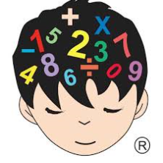
Maths

Slide 10
Maths in Year 1- how is it taught?
In the Autumn term, maths is taught similarly to Reception to aid transition..
Small group work
Practical (use of concrete objects)
Problem solving
Appropriate challenges
Once the children are ready, children will be taught as a whole class and activities differentiated.

Slide 11
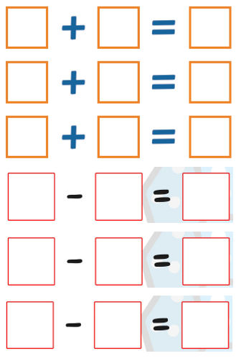
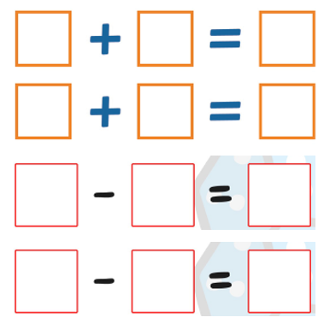
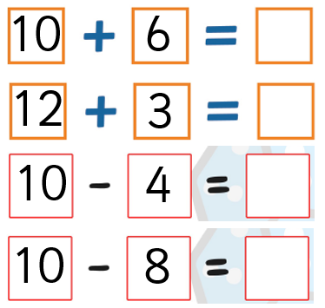
Obj: To add and subtract one and two digit numbers.
Use of 0-20 dice
Use of 0-10 dice
Use of a numberline or objects.
All children are challenged to their own appropriate level

Slide 12
Maths in Year 1- coverage.
Maths is split into 7 areas.
Number: Number and place value
Number: Addition and subtraction
Number: Multiplication and division
Number: Fractions
Measurement
Geometry: Properties of shapes
Geometry: Position and direction

Slide 15
Maths in Year 1- outcomes and expectations.
On your handout are the learning objectives that are covered in Maths from the Year 1 programme of study.
Ultimately, the expectation is that all children are treated as an individual and that they make their own individual progress.

Slide 16
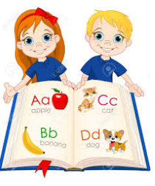
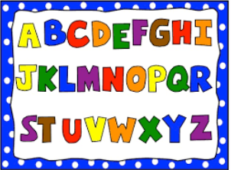
English

Slide 17
English in Year 1- how is it taught?
In the Autumn term, English is taught similarly to Reception to aid transition.
Small group work for guided writing
Emphasis on using phonic sound mats to develop
independence in writing
1:1 reading with both teacher and TA weekly
Once the children are ready, children will be taught as a whole class and activities differentiated.

Slide 18
English in Year 1- how is it taught?
English is split into 8 main areas:
Writing
Reading 1:1 with both teacher and TA weekly
Guided reading
Communication
Phonics
Spellings
Handwriting
SPAG

Slide 19
Phonics.
Phonics is taught across the year group in 5 ability groups. These are fluid and children move up or down depending on their ability and needs. Throughout the year, children will sit practice phonics checks to ensure they are making progress and any gaps in their knowledge can be picked up early.
Phonics groups are the same as spelling groups and are taught by the same adult.

Slide 20
Guided Reading.
Children are split into 4 ability groups to read a text that is appropriate to their ability (lighthouse books scheme). They also have a comprehension task to complete independently linked with the book.

Slide 21
Spellings.
Emphasis starts on high frequency words.
Yellow books
Once the children are ready and can confidently and independently apply high frequency words correctly into their writing, they will move on to spelling rules linked to different areas e.g phonics, suffixes, prefixes and rules such as ‘tch’ words

Slide 22
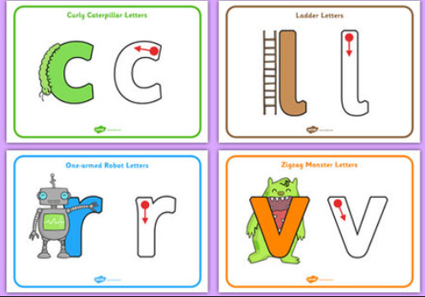
Handwriting.
Letter formation is taught in 4 letter families.
Curly caterpillar letters
Ladder letters
One armed robot letters
Zig zag monster letters

Slide 23
Reading.
Children read on a 1:1 basis with both a teacher and a TA weekly and this is recorded in their reading diary.
We also share books with the children daily, both fiction and non-fiction and sometimes an audio book through the interactive whiteboard.

Slide 24
The importance of reading.
This year, as a school, we are encouraging a love of reading. We currently read to and with your child throughout the week but, in addition, the whole school will be reading at 3:10 everyday. We cannot stress enough how important it is to read with your child everyday.
Research shows that reluctant readers will read 50,000 words a year but keen readers will read up to 1,000,000 words. We need to close this gap.

Slide 25
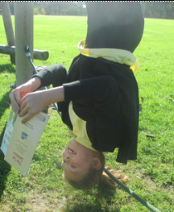
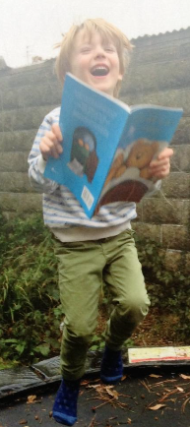
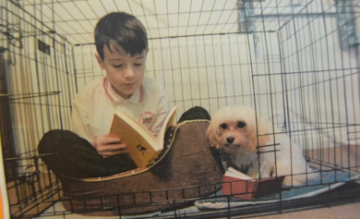
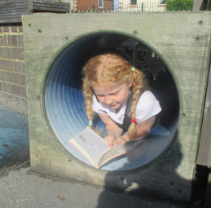
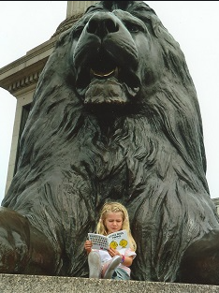
Reading in strange places
In Year 1 we would like the children to be excited about reading so we are encouraging them to read in ‘strange places.’ Take a photo of your child and bring it into school and we will display it in the classroom.

Slide 26
English in Year 1- outcomes and expectations.
On your handout are the learning objectives that are covered in English from the Year 1 programme of study.
Ultimately, the expectation is that all children are treated as an individual and that they make their own individual progress.

Slide 27
Thank you very much for your time.

