Slide 1
Flu 2023/2024
Birmingham Community Healthcare NHS Trust

Slide 2
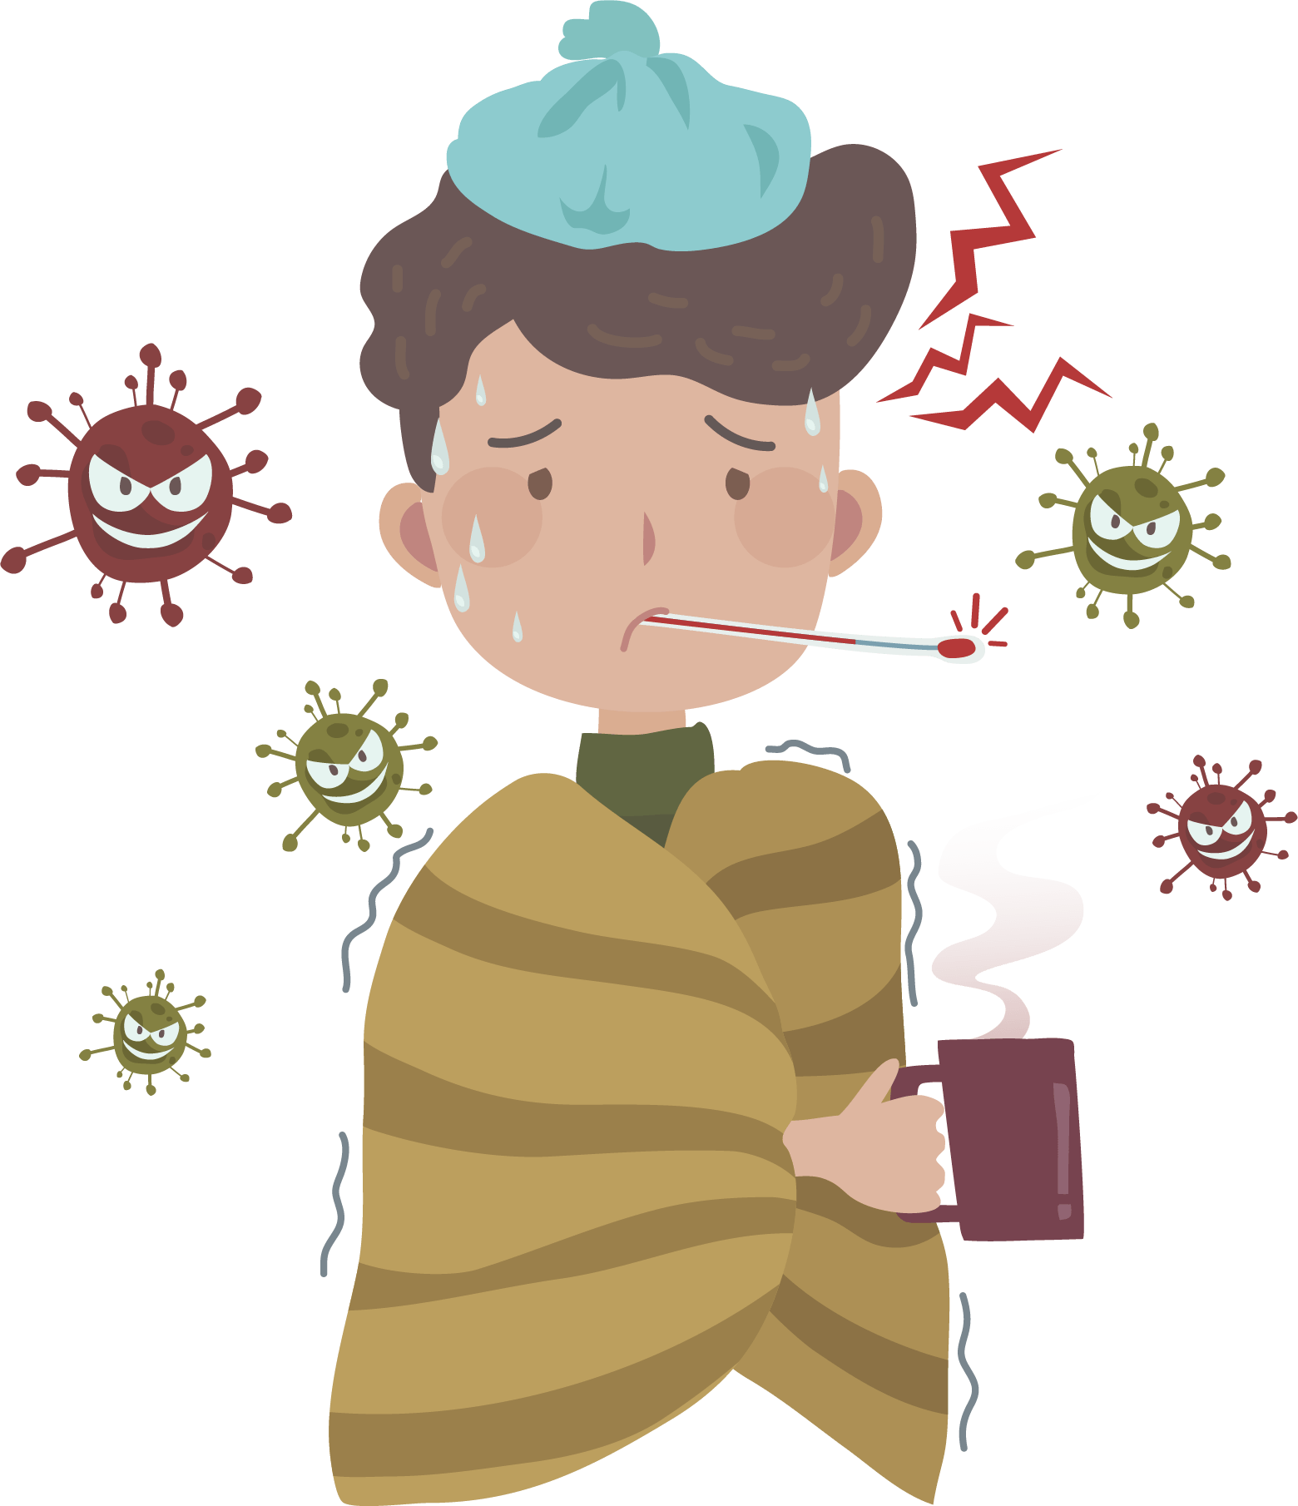
What Is Flu?
A common viral illness.
Highly contagious.
Affects nose, throat and lungs.
Can cause mild to severe illness.

Slide 3
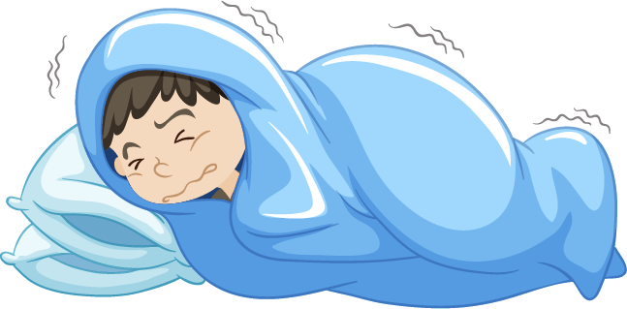
Symptoms Of Flu
Can come on very suddenly
High temperature
An aching body
Feeling very tired
A dry cough
A sore throat
Headache
Difficulty sleeping
Loss of appetite
Feeling and/or being sick
Tummy pain

Slide 4
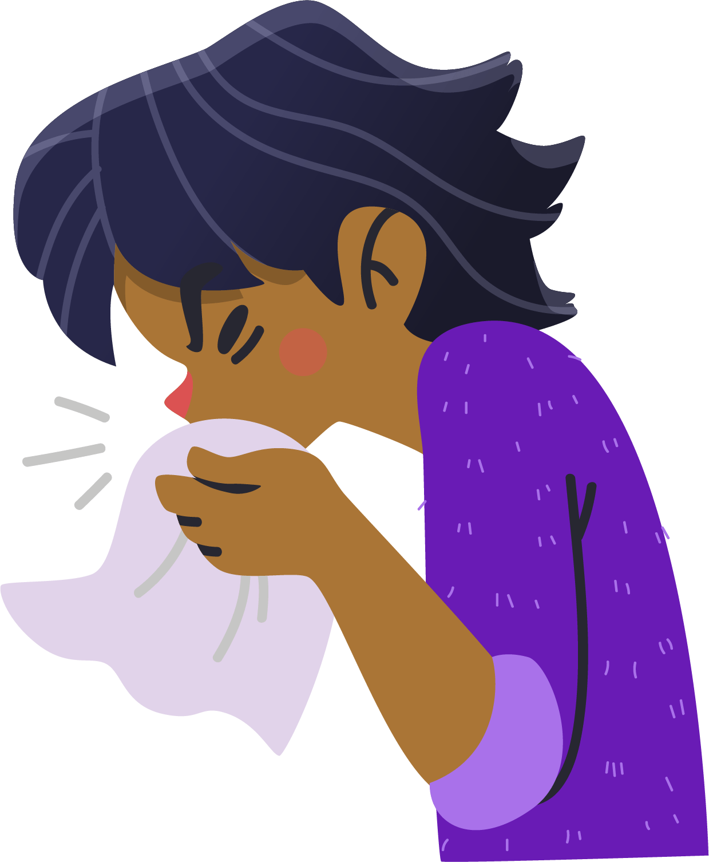
How is Flu Spread?
Coughs and sneezes.
Surfaces which have the flu virus on them.
Close contact with people who have the virus.
Skin to skin contact (eg a handshake).

Slide 5
How To Look After Yourself If You Have Flu
There is no treatment or anti-biotics as these have no effect on symptoms or recovery.
Rest and sleep.
Keep warm.
Drink plenty of water/squash.
Some people who have flu need Hospital treatment.

Slide 6
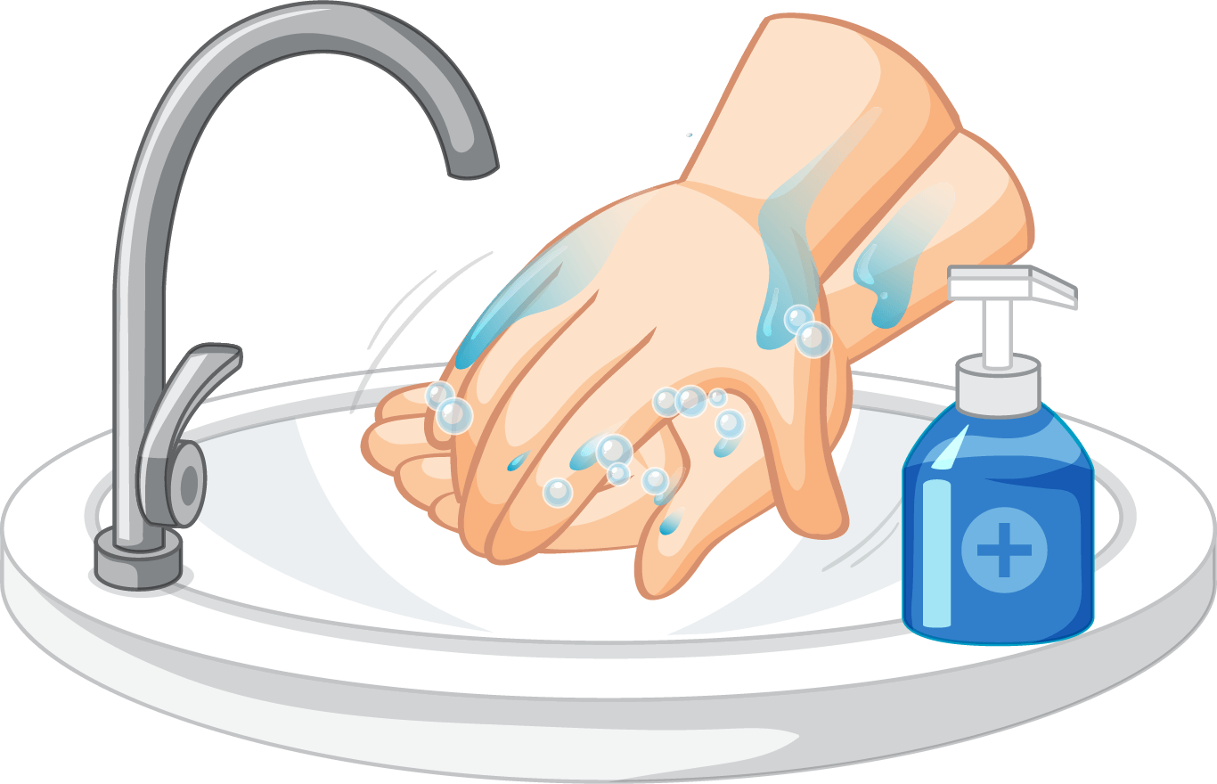
How To Prevent Flu?
Wash your hands often with warm water and soap.
Cover your mouth and nose with a tissue when you cough or sneeze.
Put used tissues in the bin.
Get your flu vaccine!

Slide 7
Flu Vaccine
Flu vaccines are safe and effective.
Most children are offered the nasal flu vaccine (no injection!)
Not everyone can have the nasal flu vaccine – there is an alternative!!

Slide 8
Flu Video (Primary)
Primary flu presentation – flu busters
Flu Busters on Vimeo

Slide 9
Flu Video (Secondary)
Health for Teens Flu video:
Nasal Flu Vaccination on Vimeo

Slide 10
Thankyou for listening!

